Slide 1

Pennant Technologies Private Limited
JDBC Transactions

Slide 4
Transaction Management in JDBC
Transaction represents a single unit of work.
The ACID properties describes the transaction management well. ACID stands for Atomicity, Consistency, isolation and durability.
Atomicity means either all successful or none.
Consistency ensures bringing the database from one consistent state to another consistent state.Isolation ensures that transaction is isolated from other transaction.
Durability means once a transaction has been committed, it will remain so, even in the event of errors, power loss etc.
Advantage of Transaction Mangaement
fast performance It makes the performance fast because database is hit at the time of commit.
If your JDBC Connection is in auto-commit mode, which it is by default, then every SQL statement is committed to the database upon its completion.
That may be fine for simple applications, but there are three reasons why you may want to turn off the auto-commit and manage your own transactions −
To increase performance.
To maintain the integrity of business processes.
To use distributed transactions.

Slide 5
JDBC transactions
A transaction is a logical unit of work. To complete a logical unit of work, several actions may need to be taken against a database.
Transactional support allows applications to ensure the following:
All the steps to complete a logical unit of work are followed.
When one of the steps to the unit of work files fails, all the work done as part of that logical unit of work can be undone and the database can return to its previous state before the transaction began.
Transactions are used to provide data integrity, correct application semantics, and a consistent view of data during concurrent access. All Java™ Database Connectivity (JDBC) compliant drivers must support transactions.

Slide 6
JDBC transactions
All transactional work is handled at the Connection object level.
When the work for a transaction completes, it can be finalized by calling the commit method.
If the application aborts the transaction, the rollback method is called.
All Statement objects under a connection are a part of the transaction.
This means is that if an application creates three Statement objects and uses each object to make changes to the database, when a commit or rollback call happens, the work for all three statements either becomes permanent or is discarded.
The commit and rollback SQL statements are used to finalize transactions when working purely with SQL.
These SQL statements cannot be dynamically prepared and you should not attempt to use them in your JDBC applications to complete transactions.

Slide 7
JDBC transactions
JDBC auto-commit mode
By default, JDBC uses an operation mode called auto-commit. This means that every update to the database is immediately made permanent.
Transaction isolation levels
Transaction isolation levels specify what data is visible to statements within a transaction. These levels directly impact the level of concurrent access by defining what interaction is possible between transactions against the same target data source.
Savepoints
Savepoints allow the setting of "staging points" in a transaction. Savepoints are checkpoints that the application can roll back to without throwing away the entire transaction.

Slide 8
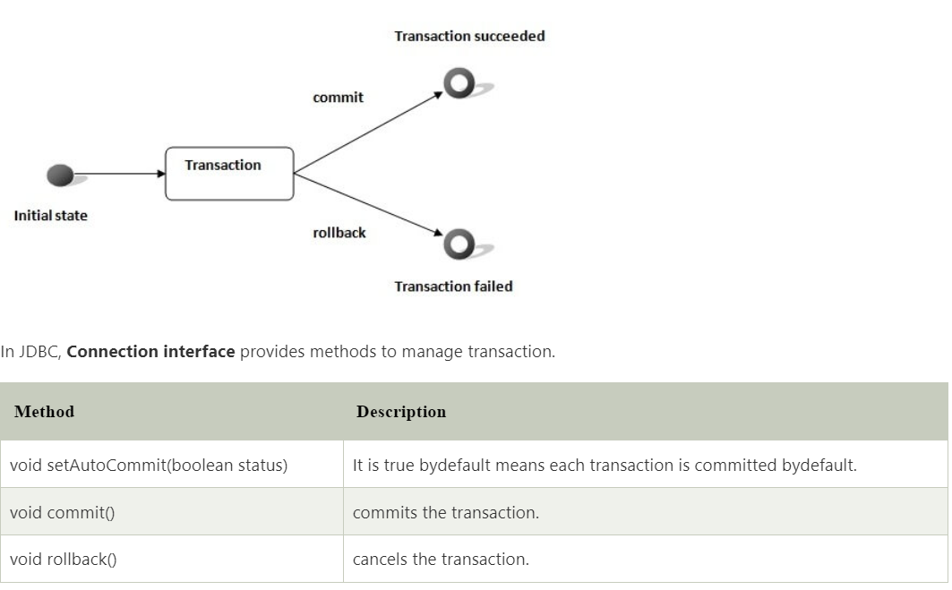

Slide 9
Simple example of transaction management in jdbc using Statement
Let's see the simple example of transaction management using Statement.
import java.sql.*;
class FetchRecords{
public static void main(String args[])throws Exception{
Class.forName("oracle.jdbc.driver.OracleDriver");
Connection con=DriverManager.getConnection("jdbc:oracle:thin:@localhost:1521:xe","system","oracle");
con.setAutoCommit(false);
Statement stmt=con.createStatement();
stmt.executeUpdate("insert into user420 values(190,'abhi',40000)");
stmt.executeUpdate("insert into user420 values(191,'umesh',50000)");
con.commit();
con.close(); }}

Slide 10
JDBC transaction using Prepared statement –
public static void main /* main method */ (string args [])
Class.forName ("database driver name")
Connection con_object DriverManager.getConnection ("connection string")
Con_object.setAutoCommit (value)
PreparedStatement Prp_stmt_object = con_object.prepareStatement ("SQL query");
Prp_stmt_object.executeUpdate (");
con_object.commit ();
con_object.rollback ();
Con.close ();

Slide 11
Parameter description syntax of JDBC transaction
Database driver name – To connect the specified database we need a database driver name. We need to load the database driver to connect to the specified database.
Connection String – This contains the string as username, password, hostname and port of the database server.
SetAutoCommit – This is the method of connection interface used in transactions. The default value of this method is true, means we can commit all the transaction without issuing commit command. We can disable it by issuing Boolean values as false.
Commit – It is a method of connection interface which was used to commit the transaction which was running of the database server. I suppose we have not setAutoCommit method as false we need to issue a commit command after a successful transaction.
Rollback – This method is used to cancel the previously running transaction on the database server. We can rollback the transaction before it’s committing. We can roll back the transaction after setting the value false of setAutoCommit method.
Execute update – This method is used to execute the statement of PreparedStatement method. It will execute the statement which was written under the PreparedStatement.

Slide 12
How Transactions work in JDBC?
Transaction is nothing but the block of SQL query which was executed in a single block of statement.
As we know that all JDBC connections are in auto-commit mode, using this mode all the transactions will be committed after the successful execution of each transaction.
By default JDBC connection mode is set as true, we can change this value using defining the setAutoCommit method value as false.
Below are the key points to need to disable autocommit of transactions in JDBC are as follows.
We can use distributed transactions by disabling the auto-commit parameter.
We can increase the performance of the application.
We can also maintain the integrity of a business by disabling the auto-commit parameter of transactions.

Slide 13
How Transactions work in JDBC?
Below are the methods of connection interface which was used in a transaction are as follows.
Void commit() method
Void setAutoCommit() method
Void rollback() method
Void setSavePoint() method
Void releaseSavePoint() method
JDBC setAutoCommit contains the Boolean value as true or false, we can set the value as true or false using setAutoCommit method. I suppose we have set value as true it will automatically commit all the transactions.
The savepoint will give us additional control on the transaction which was we have done on database server using transaction.
The release savepoint method is used to delete the created savepoint. We can use the setSavePoint method to create a new save point.
We have no need to update the transaction after successful execution.
Using transactions we can provide the data integrity, consistent view and correct application semantics to the java compliant drivers.

Slide 14
How Transactions work in JDBC?
Below are the most important function which was used in transaction management are as follows.
Commit
Rollback
Savepoint
Savepoint is very useful in transactions to roll back a particular transaction after executing all the transactions.
We have created multiple savepoint to perform this operation on the database using transactions.
Any savepoint which was we have created it will automatically be destroyed or deleted when we have issuing rollback or commit operation on the database server.

Slide 15
Example
JDBC transaction using insert query
The below example shows transactions using the insert query are as follows. We have using the commit and setAutoCommit method.
Code:
public static void main /* main method */ (String[] args) throws Exception {
final String DB_CON = "jdbc:postgresql://localhost:5432/jdbc_tran";
final String USER_NAME = "postgres";
final String PASSWORD = "postgres";
Connection conn_tran = DriverManager.getConnection (DB_CON, USER_NAME, PASSWORD);
conn_tran.setAutoCommit (false);
System.out.println ("We have set setAutoCommit method value as false,");
Statement stmt_tran = conn_tran.createStatement ();
stmt_tran.executeUpdate ("insert into jdbc_tran values(1,'ABC')");
stmt_tran.executeUpdate ("insert into jdbc_tran values(2,'PQR')");
System.out.println ("Record inserted.");
conn_tran.commit ();
System.out.println ("Transaction committed.");}}

Slide 16
Example
JDBC transaction using update query
The below example shows transactions using update query are as follows. We have using the commit, setAutoCommit and rollback methods.
Code:
public static void main /* main method */ (String[] args) throws Exception {
final String DB_CON = "jdbc:postgresql://localhost:5432/jdbc_tran";
final String USER_NAME = "postgres";
final String PASSWORD = "postgres";
Connection conn_tran = DriverManager.getConnection (DB_CON, USER_NAME, PASSWORD);
conn_tran.setAutoCommit (false);
Statement stmt_tran = conn_tran.createStatement ();
stmt_tran.executeUpdate ("update jdbc_tran set id = 11 where id = 2 ");
System.out.println ("Record updated.");
conn_tran.commit ();
System.out.println ("Transaction committed.");
conn_tran.rollback ();
System.out.println ("Transaction roll backed.");}}

Slide 17
Example
JDBC transaction using delete query
The below example shows transactions using delete query are as follows. We have using commit, setAutoCommit and rollback methods.
Code:
public static void main /* main method */ (String[] args) throws Exception {
final String DB_CON = "jdbc:postgresql://localhost:5432/jdbc_tran";
final String USER_NAME = "postgres";
final String PASSWORD = "postgres";
Connection conn_tran = DriverManager.getConnection (DB_CON, USER_NAME, PASSWORD);
conn_tran.setAutoCommit (false);
Statement stmt_tran = conn_tran.createStatement ();
stmt_tran.executeUpdate ("Delete from jdbc_tran where id = 1");
System.out.println ("Record deleted.");
conn_tran.commit ();
System.out.println ("Transaction committed.");
conn_tran.rollback ();
System.out.println ("Transaction roll backed.");} }

Slide 18
DriverManager class
The DriverManager class is the component of JDBC API and also a member of the java.sql package.
The DriverManager class acts as an interface between users and drivers.
It keeps track of the drivers that are available and handles establishing a connection between a database and the appropriate driver.
It contains all the appropriate methods to register and deregister the database driver class and to create a connection between a Java application and the database.
The DriverManager class maintains a list of Driver classes that have registered themselves by calling the method DriverManager.registerDriver().
Note that before interacting with a Database, it is a mandatory process to register the driver; otherwise, an exception is thrown.

Slide 19
DriverManager class
The DriverManager class in Java provides the basic service for managing a set of Java Database Connectivity (JDBC) drivers. It maintains a list of database drivers.
The DriverManager class is part of the java.sql package. It is a singleton class. Only one instance of this class is created in a JVM.
The DriverManager class is used as part of the JDBC API via the static getConnection() method.
The JDBC API is the standard for database-independent connectivity between the Java programming language and SQL databases and other tabular data sources, such as spreadsheets or flat files.

Slide 20
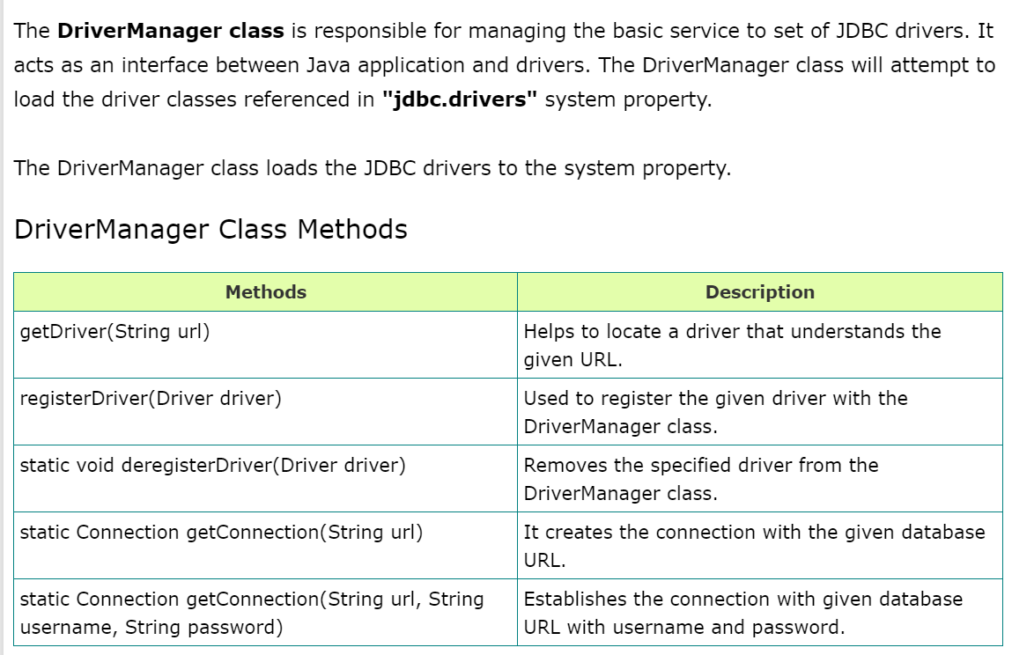

Slide 21
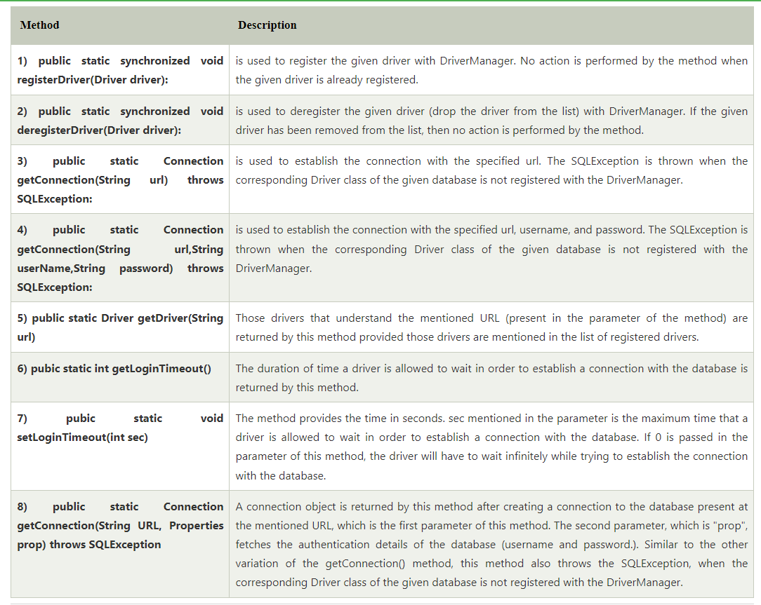
Methods of the DriverManager Class

Slide 22
How it works
We can register different drivers with the DriverManager class using the registerDriver() method.
When we try to establish a connection with the database, DriverManager looks for a suitable driver from its list. We can search for drivers that are registered with DriverManager using the getDriver(String url) method. Here, url is the connection URL of the database we want to connect to.
If the driver is found, this method uses the driver to connect to the database. If multiple drivers are found, it uses the first driver in the list that is able to connect to the database.
The DriverManager class is used as a connection factory for establishing JDBC connections. This connection object represents a database link that allows us to run SQL queries and perform other database operations.
The DriverManager class is not thread-safe. Hence, we should not use it in a multi-threaded environment. We need to create a new instance of the DriverManager class in each thread.

Slide 23
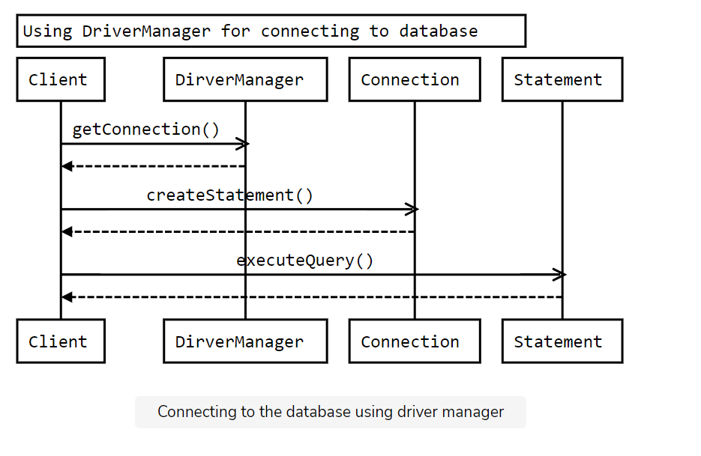

Slide 24
DriverManager Example Program
package com.STH.JDBC;
import java.sql.DriverManager;
import java.sql.SQLException;
public class DriverManagerExample {
public static void main(String[] args) throws ClassNotFoundException, SQLException {
// TODO Auto-generated method stub
Class.forName("oracle.jdbc.driver.OracleDriver");
//Get Driver method
System.out.println(" Get Driver = " + DriverManager.getDriver("jdbc:oracle:thin:system/pass123@localhost"));
//Print default Login Timeout Value
System.out.println("Default Login Timeout = " + DriverManager.getLoginTimeout());
//Setting Login Timeout Value as 1000ms
System.out.println("Set Login Timeout");
DriverManager.setLoginTimeout(1000);
//Printing Login Timeout Value After set the value
System.out.println(" After Setting time Max Login Timeout = " + DriverManager.getLoginTimeout()); } }

Slide 25
Connection interface
A Connection is a session between a Java application and a database. It helps to establish a connection with the database.
The Connection interface is a factory of Statement, PreparedStatement, and DatabaseMetaData, i.e., an object of Connection can be used to get the object of Statement and DatabaseMetaData. The Connection interface provide many methods for transaction management like commit(), rollback(), setAutoCommit(), setTransactionIsolation(), etc.
By default, connection commits the changes after executing queries.
Commonly used methods of Connection interface:
1) public Statement createStatement(): creates a statement object that can be used to execute SQL queries.
2) public Statement createStatement(int resultSetType,int resultSetConcurrency): Creates a Statement object that will generate ResultSet objects with the given type and concurrency.
3) public void setAutoCommit(boolean status): is used to set the commit status. By default, it is true.
4) public void commit(): saves the changes made since the previous commit/rollback is permanent.
5) public void rollback(): Drops all changes made since the previous commit/rollback.
6) public void close(): closes the connection and Releases a JDBC resources immediately.

Slide 26
Connection Interface Fields
There are some common Connection interface constant fields that are present in the Connect interface. These fields specify the isolation level of a transaction.
TRANSACTION_NONE: No transaction is supported, and it is indicated by this constant.
TRANSACTION_READ_COMMITTED: It is a constant which shows that the dirty reads are not allowed. However, phantom reads and non-repeatable reads can occur.
TRANSACTION_READ_UNCOMMITTED: It is a constant which shows that dirty reads, non-repeatable reads, and phantom reads can occur.
TRANSACTION_REPEATABLE_READ: It is a constant which shows that the non-repeatable reads and dirty reads are not allowed. However, phantom reads and can occur.
TRANSACTION_SERIALIZABLE: It is a constant which shows that the non-repeatable reads, dirty reads as well as the phantom reads are not allowed.

Slide 27
Statement interface
The Statement interface provides methods to execute queries with the database. The statement interface is a factory of ResultSet i.e. it provides factory method to get the object of ResultSet.
Commonly used methods of Statement interface:
The important methods of Statement interface are as follows:
1) public ResultSet executeQuery(String sql): is used to execute SELECT query. It returns the object of ResultSet.
2) public int executeUpdate(String sql): is used to execute specified query, it may be create, drop, insert, update, delete etc.
3) public boolean execute(String sql): is used to execute queries that may return multiple results.
4) public int[] executeBatch(): is used to execute batch of commands.

Slide 28
Example of Statement interface
Let’s see the simple example of Statement interface to insert, update and delete the record.
import java.sql.*;
class FetchRecord{
public static void main(String args[])throws Exception{
Class.forName("oracle.jdbc.driver.OracleDriver");
Connection con=DriverManager.getConnection("jdbc:oracle:thin:@localhost:1521:xe","system","oracle");
Statement stmt=con.createStatement();
//stmt.executeUpdate("insert into emp765 values(33,'Irfan',50000)");
//int result=stmt.executeUpdate("update emp765 set name='Vimal',salary=10000 where id=33");
int result=stmt.executeUpdate("delete from emp765 where id=33");
System.out.println(result+" records affected");
con.close(); }}

Slide 29
ResultSet interface
The object of ResultSet maintains a cursor pointing to a row of a table. Initially, cursor points to before the first row.
By default, ResultSet object can be moved forward only and it is not updatable.
But we can make this object to move forward and backward direction by passing either TYPE_SCROLL_INSENSITIVE or TYPE_SCROLL_SENSITIVE in createStatement(int,int) method as well as we can make this object as updatable by:
Statement stmt = con.createStatement(ResultSet.TYPE_SCROLL_INSENSITIVE,
ResultSet.CONCUR_UPDATABLE);
Types of ResultSet
The following are the two types of ResultSet:
Forward-only: This cursor can only move through the ResultSet object from the beginning to the end.
Scrollable: This cursor can only move forward and backward through the ResultSet object, and jump to specific rows.

Slide 30
ResultSet Types
In default, we can iterate the data/values in ResultSet which have returned as an output of the executed SQL statement in the forward direction.
We can iterate the values in other directions using Scrollable ResultSet.
We can specify the type and concurrency of ResultSet while creating Statement, PreparedStatement, and CallableStatement objects.
There are 3 types in ResultSet. They are:
TYPE_FORWARD_ONLY: It is the default option, where the cursor moves from start to end i.e. in the forward direction.
TYPE_SCROLL_INSENSITIVE: In this type, it will make the cursor to move in both forward and backward directions. If we make any changes in the data while iterating the stored data it won’t update in the dataset if anyone changes the data in DB. Because the dataset has the data from the time the SQL query returns the Data.
TYPE_SCROLL_SENSITIVE: It is similar to TYPE_SCROLL_INSENSITIVE, the difference is if anyone updates the data after the SQL Query has returned the data, while iterating it will reflect the changes to the dataset.

Slide 31
ResultSet Concurrency
There are 2 modes of Concurrency in ResultSet. They are:
ResultSet.CONCUR_READ_ONLY: It is the default concurrency mode. We can only read the data in the ResultSet. Updation is not applicable.
ResultSet.CONCUR_UPDATABLE: We can update the data in the ResultSet object.
Some databases don’t support concurrency mode for all ResultSet types. In that case, we need to check whether they support our desired type and concurrency mode using supportsResultSetConcurrency() method.
Methods In ResultSet Interface
There are 4 categories of ResultSet methods. They are:
Navigational Methods
Getter Methods
Setter Methods
Miscellaneous Methods

Slide 32
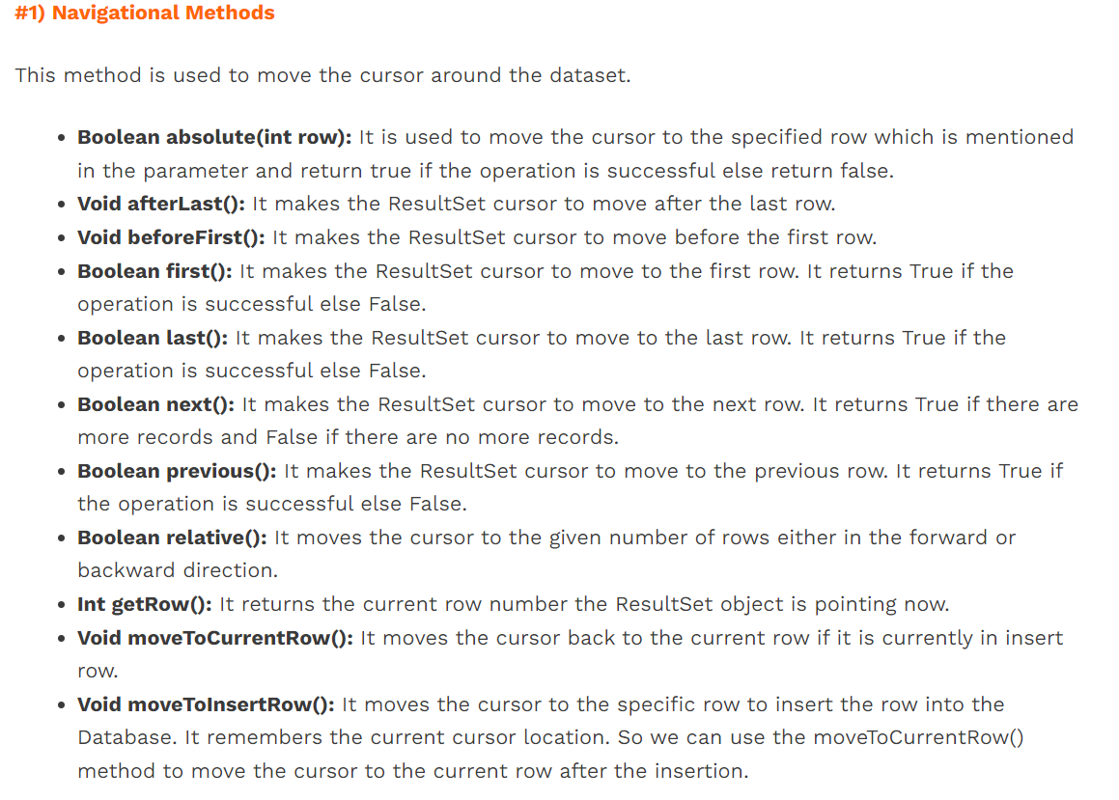

Slide 33
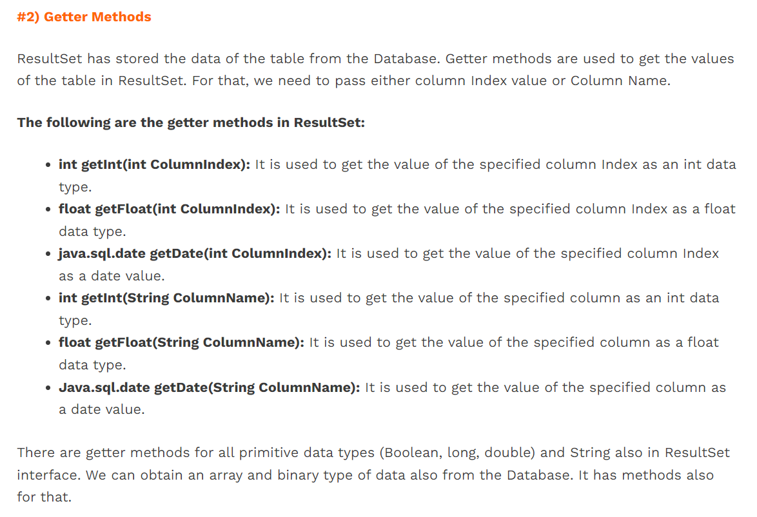

Slide 34
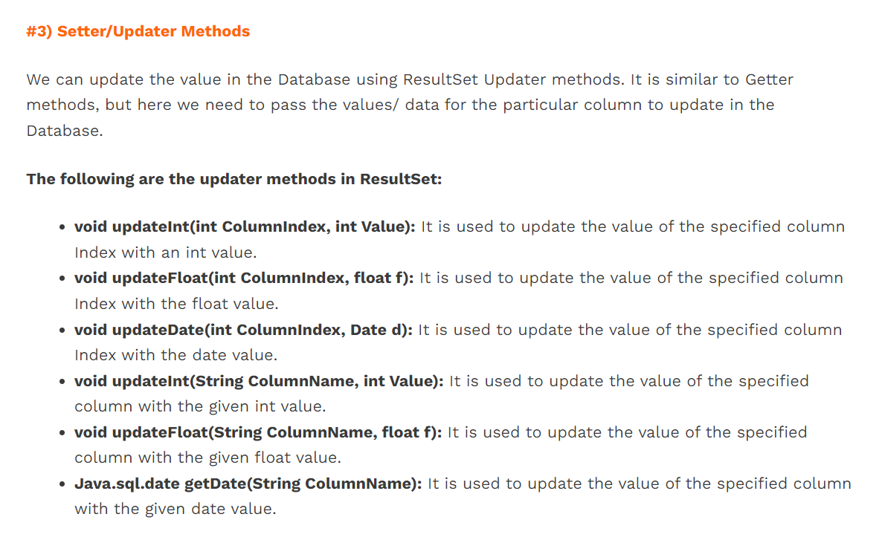

Slide 35
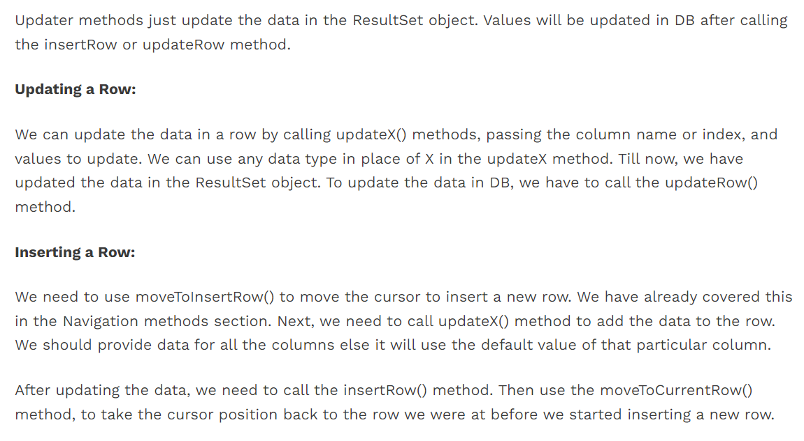

Slide 36
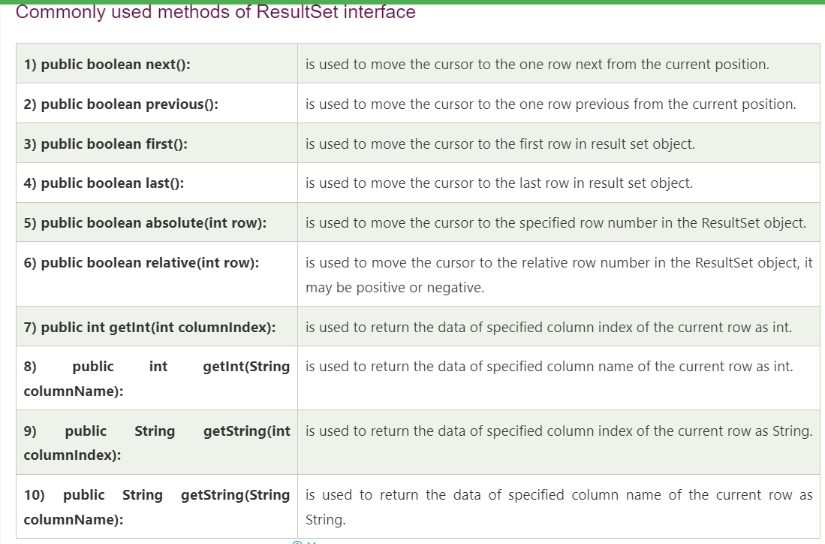

Slide 37
Example of Scrollable ResultSet
Let’s see the simple example of ResultSet interface to retrieve the data of 3rd row.
import java.sql.*;
class FetchRecord{
public static void main(String args[])throws Exception{
Class.forName("oracle.jdbc.driver.OracleDriver");
Connection con=DriverManager.getConnection("jdbc:oracle:thin:@localhost:1521:xe","system","oracle");
Statement stmt=con.createStatement(ResultSet.TYPE_SCROLL_SENSITIVE,ResultSet.CONCUR_UPDATABLE);
ResultSet rs=stmt.executeQuery("select * from emp765");
//getting the record of 3rd row
rs.absolute(3);
System.out.println(rs.getString(1)+" "+rs.getString(2)+" "+rs.getString(3));
con.close(); }}

